Slide 1

Fellowship of the Heart
Getting Started — the Four Connects, walked around the table on alternating evenings
Evening Series 2026–27 · at the Tittle home · v1.5E DRAFT
All Scripture: ESV · The Companion lesson plans carry the full scripts — these slides carry the room
1
Notes:
DECK TITLE · pre-session · DIVIDER
On screen as the room assembles on night one. All Scripture ESV; the plans carry the scripts; these slides carry the room — and these notes carry you.

Slide 2
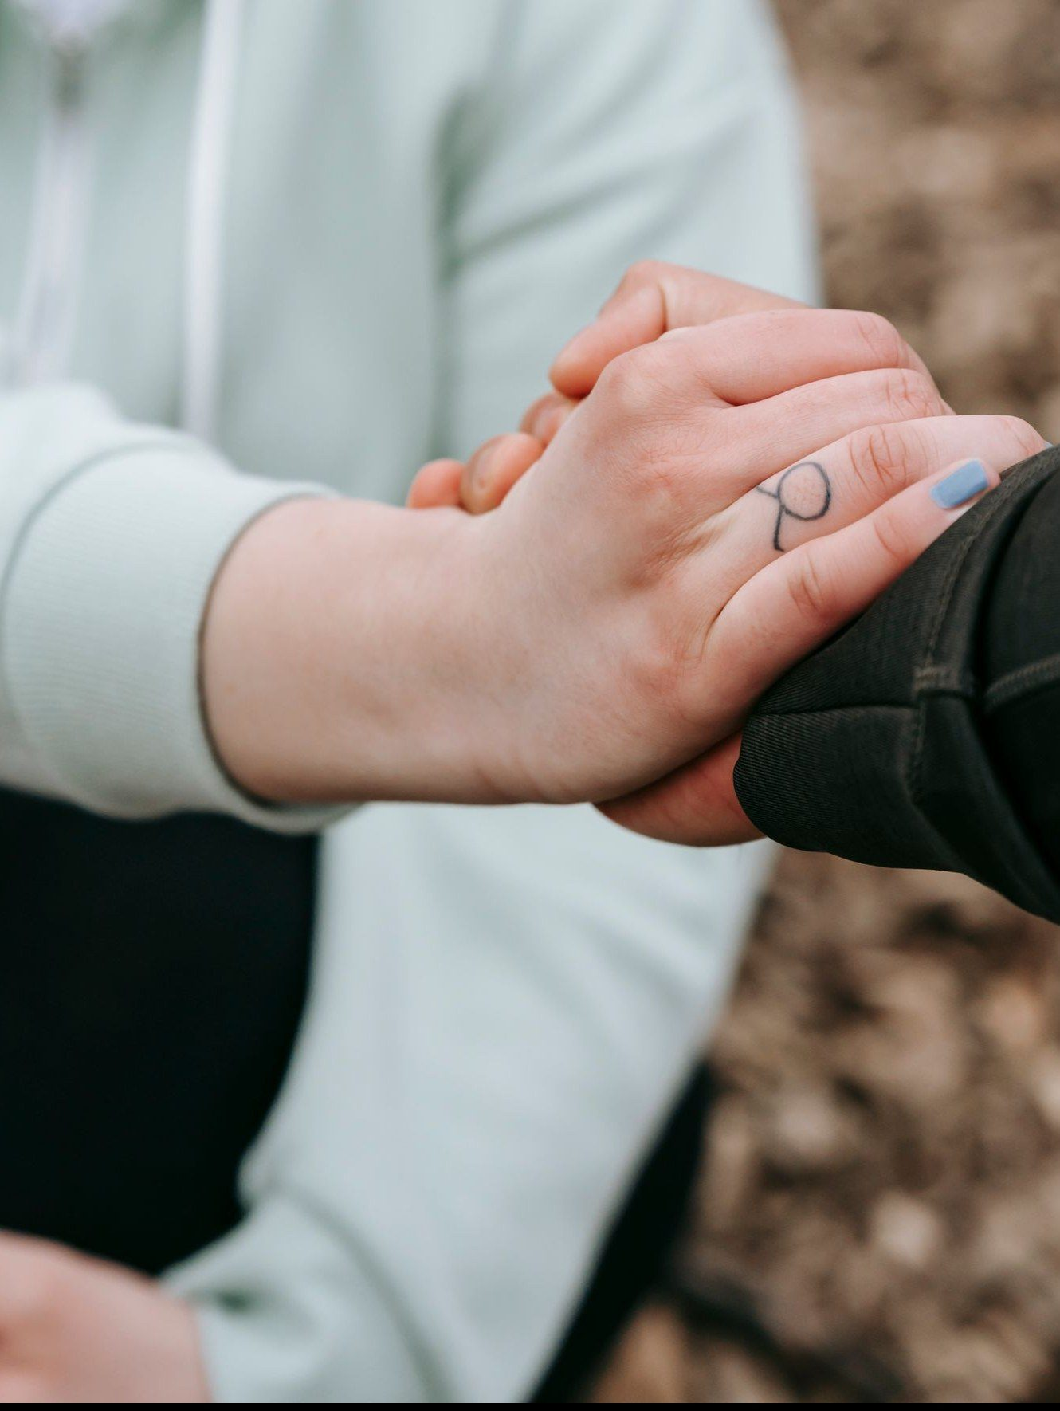
SESSION 6
Safe and Brave Together
Confession and restoration in an age-appropriate community
Quarter 1: Connect with Self & Others
81
Notes:
S6 · pre-session · DIVIDER
On screen through dinner and as the circle forms. Greet at the door — the slide holds the room.

Slide 3




Where We Are — the Four Connects
Session 6 stands deeper in the second box — Connect with Others. Each connection makes the next one real (Matt. 22:37–40).
82
Notes:
S6 · WELCOME · LEAD: CONTAINER HOLDER · GROUNDING — every session opens on this map
BEATS:
1. Locate tonight on the map, plainly: Session 6 stands deeper in the second box — Connect with Others. Each connection makes the next one real (Matt. 22:37–40).
2. The four boxes are one journey — each connection makes the next one real — rooted in the two great commandments: love God, love neighbor (Matt 22:37–40).
3. This is also the 'where we are on the map' minute the welcome owes any newcomer.
CUES: Two minutes at most; then tonight's road.

Slide 4

Session 6 — Tonight’s Road
1 Welcome and centering
2 Wk 5 check-in
3 James 5:16 and 1 John 1:9 — confession as architecture
4 The place, the pattern, the pull
5 Companion demo
6 Bridge to the groups
7 Confession-and-restoration in small groups
8 Merge and shared blessing
9 Between-session practice + the room’s question
10 The Leader Feedback Round — both leaders
11 Closing container
83
Notes:
S6 · 7:00–8:30 · LEAD: BOTH LEADERS
BEATS:
1. Confession-and-restoration night — second-highest-risk after Weeks 3–4. Section 6 re-read beforehand; backup on call 6:30–11:00; tissues in every space; the Breakout Card printed, one per group and a spare.
2. Shape: open, check-in, twelve minutes of teaching (the architecture, then the place, the pattern, the pull), YOUR demo, bridge, 33-minute practice in small groups — by gender by default, pairs or one circle by your judgement (Companion, then parents, then teens), merge and shared blessing, Examen plus the three questions carried home, feedback, close. Quarter 1 ends today.
3. Every parent was pre-briefed this week: own struggles, yes; the marriage's raw material, no; anything about the teen, never without asking the teen privately first.
GUARD: Frame it three times before the split: not specific sins — the place, the pattern, the pull.

Slide 5
Opening Container — the Eight Steps
1 Welcome — five minutes to open the container
2 Phones silenced and put away
3 Stand in a circle
4 One-word check-in — how you actually are, right now
5 Put out / bring in — set something down; bring a blessing in
6 Spoken commitment: “I am here. I am paying attention. I am willing to be moved.”
7 Opening prayer — “Holy Spirit, you are welcome here. Speak. We are listening.”
8 Sit. Begin.
84
Notes:
S6 · 7:00–7:08 · LEAD: CONTAINER HOLDER
BEATS:
1. Blessing; container reminder; nothing is required.
2. Say what today is NOT: we will not confess specific sins to each other in detail — scripture does not ask it, and neither do we.
3. Say what it IS: each of us names one place where we want to walk in greater honesty; the circle speaks a blessing of restoration; about three minutes per person; parents first, on purpose.
4. 'Teens, you choose your depth, and the pass is always real. The Spirit does the work; we hold the space.'
PAIR LEAD: name the leading pair in the welcome — two leaders hold tonight, and the room will see the evening handed back and forth between them; that is the design. The pair practices the session together beforehand.

Slide 6

Week 5 Check-In
• “Last week we did the friendship audit and committed to one condition, one friendship, one week.”
• “One sentence about how that practice landed.” — an arranged parent starts
• Two or three voices is plenty — optional, no pressure
85
Notes:
S6 · 7:08–7:25 · LEAD: CONTAINER HOLDER
BEATS:
1. Ninety seconds: one sentence on how the one-friendship, one-condition practice landed; the arranged parent starts.
2. Take 2–3 voluntary contributions. Do not ask for more; move on.

Slide 7
Confession as Architecture
• Two verses, two angles — 1 John 1:9 is vertical: confession to God, with full assurance. James 5:16 is horizontal: confession to one another, for healing
• Most Christians live in 1 John 1:9 and never enter James 5:16. Tonight we enter it carefully and at age
• Patterns we hide from each other tend to keep their grip — bringing them into the light, in front of trusted people, is part of what breaks it
• Not detailed sin disclosure — each person names ONE place where they want to walk in greater honesty: the place, the pattern, the pull
• The parents go first in every group — the older generation owes the younger the demonstration
• After each naming, the group speaks a specific blessing of restoration — about three minutes per person
JAMES 5:16 · 1 JOHN 1:9
“Therefore, confess your sins to one another and pray for one another, that you may be healed. The prayer of a righteous person has great power as it is working.”
“If we confess our sins, he is faithful and just to forgive us our sins and to cleanse us from all unrighteousness.”
86
Notes:
S6 · 7:25–7:31 · LEAD: CONTENT PRESENTER
BEATS:
1. Read James 5:16 and 1 John 1:9 aloud, slowly, from the physical Bible.
2. Two angles: 1 John is vertical, with full assurance — the cross secured it (1 John 1:7); James is horizontal, in community, for healing. Most Christians never enter James 5:16; today we do, carefully and at age.
3. Say the parents-first rationale plainly: the older generation owes the younger the demonstration — a teen should never be asked to be braver than their parents were three minutes earlier.
GUARD: Not Catholic-sacramental confession — a Protestant small group doing what James 5:16 says. 'The place, not the details' — this is one of the three required framings; keep count. The next slide unpacks it.

Slide 8
The Place, the Pattern, the Pull
1 The place — where you want to walk in greater honesty; where growth has stalled
e.g. how I talk about people who aren’t in the room
2 The pattern — how it keeps going: not one time, the habit you’ve stopped expecting to change
e.g. when I feel left out, I get clever at someone’s expense
3 The pull — what draws you back: the want or the fear underneath
e.g. I want to be on the inside
• Naming the place is enough. The pattern and the pull are yours to add — or to keep.
• Never named here: the details of what happened, anyone else’s part, anything about someone in this room.
87
Notes:
S6 · 7:31–7:37 · LEAD: CONTENT PRESENTER · CENTRAL — the groups depend on this slide
BEATS:
1. This is what each of us will name tonight, so go slowly. Three words; only the first is required.
2. The place: where in my life I want to walk in greater honesty — a relationship, a setting, a part of my day; where growth has stalled. Places sound like: the way I treat my brother; the faith I perform; the resentment I keep feeding; fear winning over trust.
3. The pattern: how it keeps going — not one incident but the habit, the one I have stopped expecting to change.
4. The pull: what draws me back — the want or the fear underneath; what I keep yielding to.
5. Walk the example on the slide through all three, out loud, so the room hears how the three fit together.
6. Then the two lines that make it safe: naming the place is enough — the pattern and the pull are yours to add or keep; and what is never named here — details, anyone else's part, anything about someone in this room.
PRINT: the Session 6 Breakout Card (Leader Notes folder) — one per group and a spare. It carries this slide, the form, the order and a sample blessing, so the groups have the three words in hand when they are away from the screen.
CUES: Ask 'Questions about the three words?' and wait. Get it clear here, not in the groups. If the groups stay in this room, leave the practice slide up — it carries the three words too.
GUARD: The second of the three required framings — not specific sins: the place, the pattern, the pull.

Slide 9
Companion Demo
• The Lead Companion does the practice in front of the whole room — this sets the depth and the form
• For example: “The place where I want to walk in greater honesty is how I speak about people who aren’t in the room.” — and the blessing back: “What I bless in you is the courage it took to name that. May God meet you there.”
• Pause. A pre-arranged Co-Companion speaks a brief blessing of restoration back
• For example: “In the name of Jesus, we pray restoration over the place you named — may its grip break, and may honesty grow where it held.”
• Receive it — no deflecting, no joking, no minimizing. “Thank you.”
• “That is the practice. You will do it in your group — parents first, then teens. Yours doesn’t have to look like mine.”
88
Notes:
S6 · 7:37–7:42 · LEAD: CONTENT PRESENTER
BEATS:
1. Stand; eye contact across the room. Offer the sample pattern first so nobody has to invent the form: a worked example of the naming and of the blessing back (on the slide). 'The place where I want to walk in greater honesty is ___.' One place, specific, real but not graphic.
2. Pause; a PRE-ARRANGED Co-Companion speaks the three-sentence blessing back.
3. Receive it — no deflecting, no joking, no minimizing. 'Thank you.' Sit down.
4. Close: 'That is the practice. Parents first, then teens. Yours doesn't have to look like mine. Three minutes per person.'
SUB: The demo is the leader's own material. Name YOUR one real place, written and rehearsed this week — never borrow the founder's — and arrange your blessing-giver before the session.

Slide 10
Bridge to the Groups
1 “Take what helps from the prompts. You don’t have to use any of them.”
2 The blessing card — specific, short, witnessed: “In the name of Jesus, we pray restoration over...”
3 “The container holds. Nothing leaves the group. Not even back to the main room. Especially this week.”
89
Notes:
S6 · 7:42–7:43 · LEAD: CONTENT PRESENTER · TRANSITION
BEATS:
1. Three things: the prompts are scaffolding — use or ignore; the blessing card has the form — specific, short, witnessed; the container holds — nothing leaves the group, especially this week.
2. Restate the order: Companion first, then the parents, then the teens — teens' depth is theirs; pass always allowed.
3. Name the groups and where each meets; hand each group's holder a Breakout Card; pray and send.
THE GROUPS: small groups by gender are the default — men and boys together, women and girls together. It was the teen leads' call on 7 October, and it worked better than pairs: each person has more than one witness, and the parents-first order holds inside each group. Pairs, or one circle, are the leaders' judgement for the room that night — its size and makeup, how new people are, who is a guest. Every group has an adult and a named holder who keeps the time and the order; the two-adult rule holds for any teen. A guest joins a group like anyone else and may pass.

Slide 11
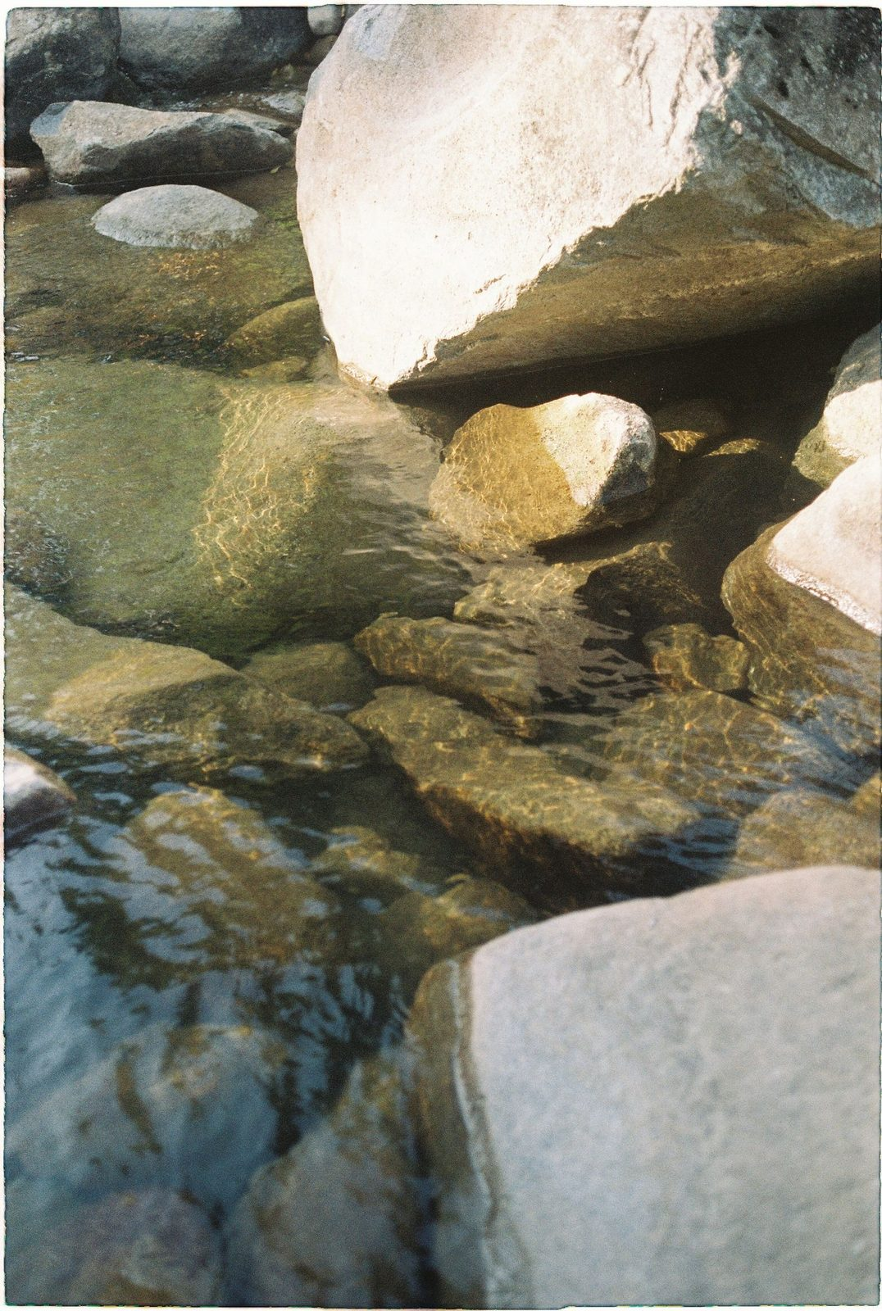
Confession and Restoration in small groups
• Ninety seconds of silence to settle in — the silence is part of the practice
1 The parents go first in every group — own struggles only, within the rails
2 The teens — each names one place at whatever depth they choose. Pass is real, honored without a flicker
• The form: “The place where I want to walk in greater honesty before God is ______.” Add the pattern or the pull if you want to
• After each naming, a brief specific blessing — a teen blessing their own parent is one of the best things this night can produce
• Closing silence — “We have named real things tonight. Let’s sit with what was said.”
90
Notes:
S6 · 7:43–8:16 · LEAD: CONTENT PRESENTER · SMALL GROUPS
BEATS:
1. Ninety seconds of silence to settle — the silence is part of the practice.
2. The parents go first in every group (3 min each), own struggles only, within the rails; then the teens at their own depth — pass honored without a flicker. A teen blessing their own parent is one of the best things this night produces.
3. Pace: three minutes per person, with a short blessing after each; a group of five runs about twenty-five minutes, so a group of six or more runs 2.5 from the start, not discovered at 8:00. Never skip anyone — compress before you cut.
4. Close with one to two minutes of held silence.
GUARD: Detailed sin disclosure gets the gentle redirect — 'the practice is the place, not the details.' A parent drifting past the rails: 'The rest belongs to the 1:1.' Watch the teens' faces during the parents' turns, not the confessing parent — weight received is a Settle Protocol matter; check in before anyone leaves the building.

Slide 12
Merge and Shared Blessing
• What happened in your group stays in your group
• “One word about what tonight was like in your body. ‘Heavy.’ ‘Lighter.’ ‘Held.’ ‘Tender.’ ‘Surprised.’” — an arranged parent starts
• Then one shared blessing of restoration over the whole room — “Hands up if you want”
• “We pray restoration into every place that was named... Holy Spirit, walk my brothers and sisters home.”
91
Notes:
S6 · 8:16–8:20 · LEAD: CONTAINER HOLDER
BEATS:
1. Settle the room. One word each on what today was like IN YOUR BODY — 'heavy', 'lighter', 'held', 'tender'; the arranged parent starts.
2. Speak the one corporate blessing of restoration over the whole room (script in the plan): real places named, restoration prayed into each, courage carried to evenings morning when the place will still be the place.
GUARD: Nothing from any group is asked for or repeated.

Slide 13

Homework — the Five-Minute Examen
• The Five-Minute Examen — five minutes with God each evening, before bed, carried through the two weeks
1 Thank Him for one specific thing from the day
2 Notice one place where you saw God moving
3 Ask Him about one place where you walked in less honesty than you wanted to today — just notice. No fixing
92
Notes:
S6 · 8:20–8:24 · LEAD: CONTENT PRESENTER
BEATS:
1. Parent Co-Companion leads. Five-Minute Examen each evening: thank Him for one specific thing; notice one place you saw God moving; ask Him about one place you walked in less honesty than you wanted today.
2. No fixing — just notice; the Spirit does the work. Carried through the two weeks; the daily morning and evening questions continue.
3. The three reflection questions ride home as a thinking point — next slide but two.

Slide 14
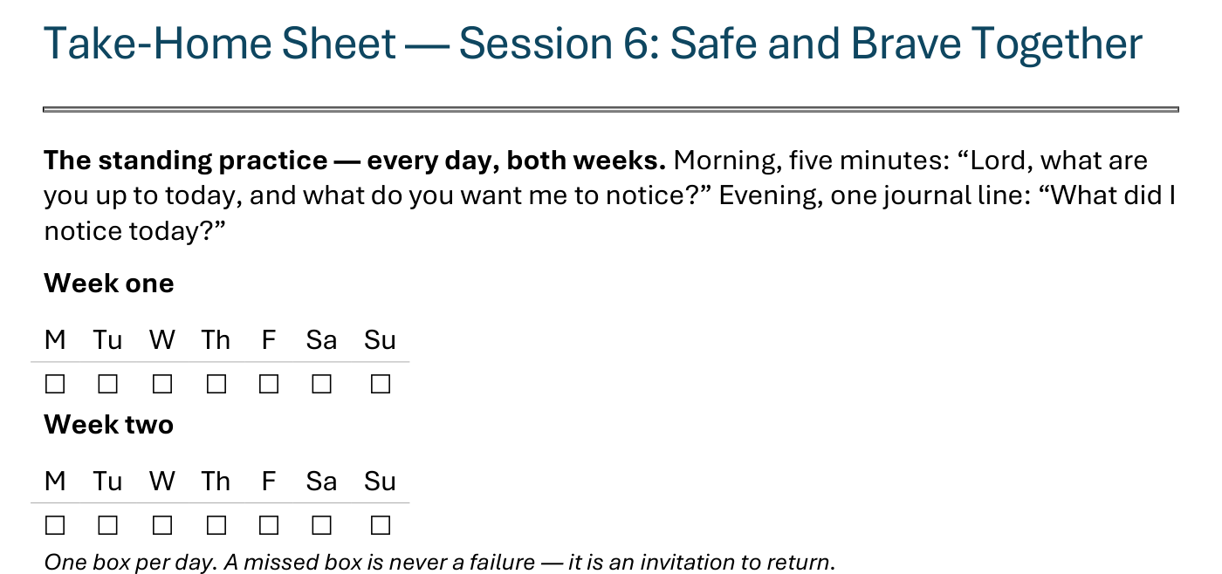
The Take-Home Sheet — the Daily Rhythm
Handed out now — this is the sheet in your hands.
93
Notes:
S6 · COMMISSIONING · LEAD: CONTENT PRESENTER
BEATS:
1. The sheet on the screen is the sheet in their hands — walk it, don't read it.
2. The standing rhythm first: the morning question, the evening journal line — one box per day on the week-grids.
3. A missed box is never a failure — it is an invitation to return.
CUES: The four parts are the next slide.

Slide 15
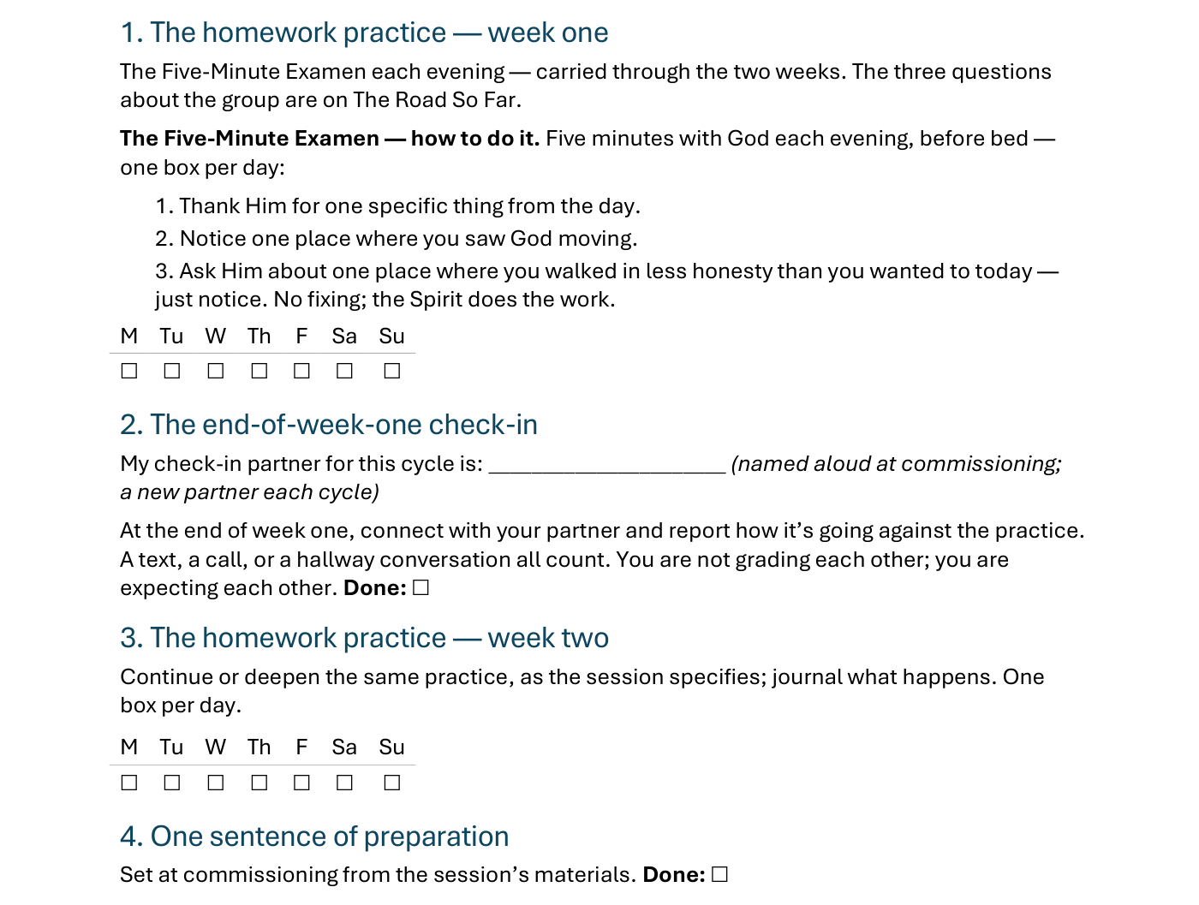
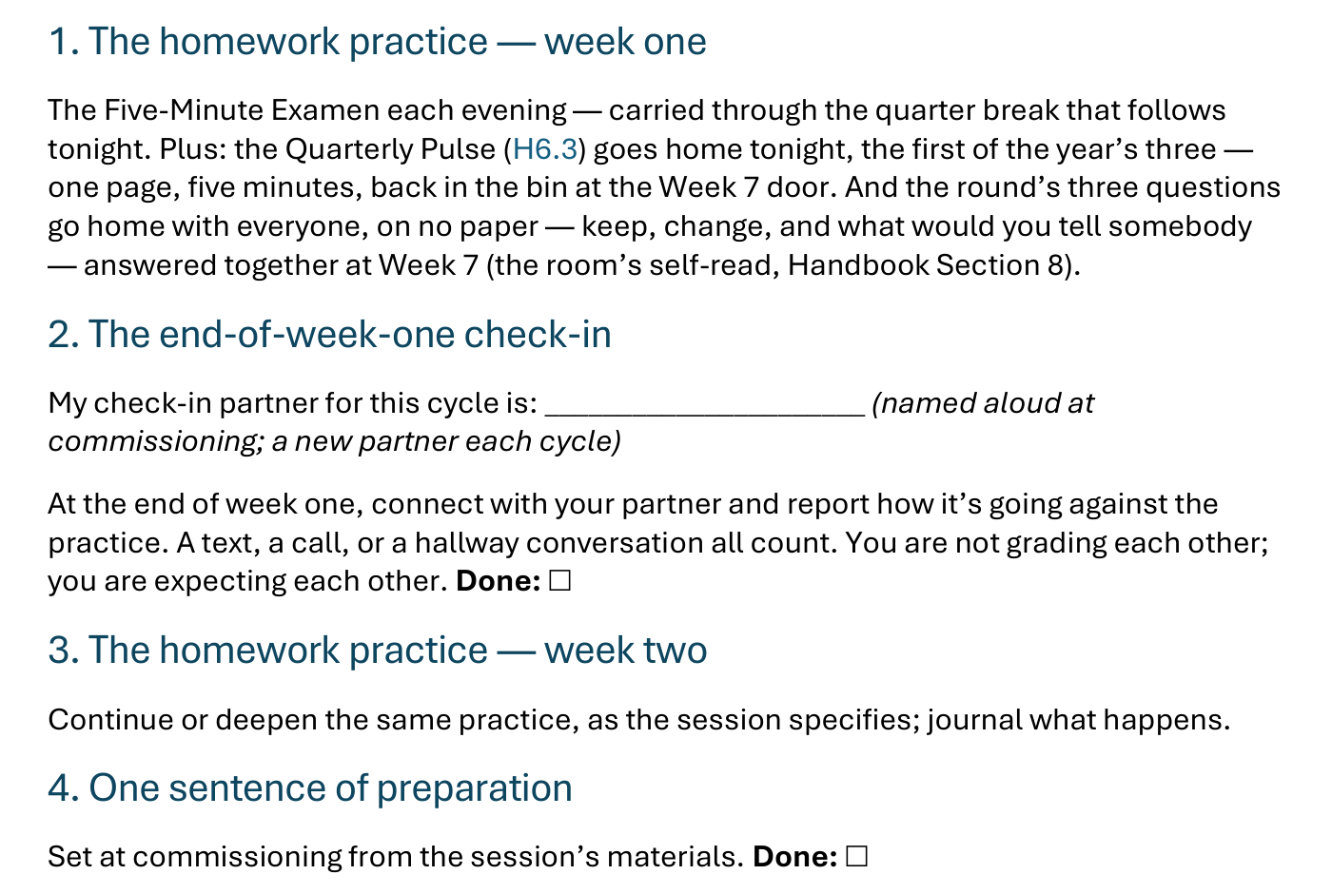
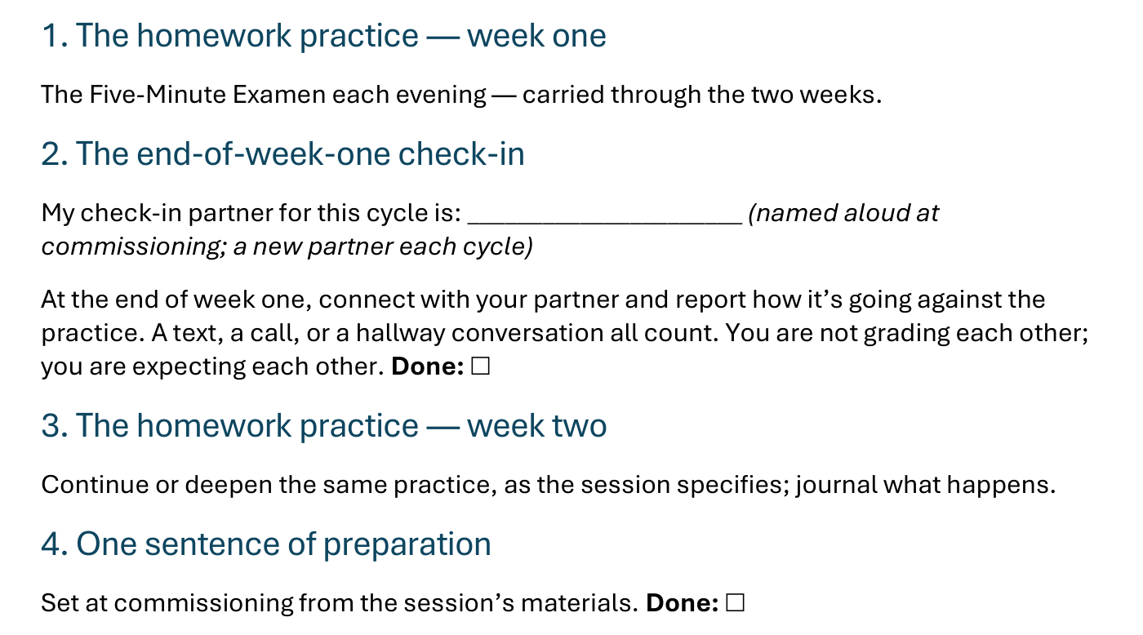
The Take-Home Sheet — the Four Parts
One practice at a time — and a partner expecting you at the end of week one.
94
Notes:
S6 · COMMISSIONING · LEAD: CONTENT PRESENTER
BEATS:
1. The four parts, in order: the homework practice, week one; the end-of-week-one check-in; the homework practice, week two; one sentence of preparation.
2. Check-in partners are named aloud before leaving this slide — the sheet has the line to write the name.
GUARD: The sheet-walk, not a re-teach.

Slide 16
Three Questions, Carried Home
Every week we close the same way — the leader’s reflection, then the room’s. Tonight the same questions ride home with all of us — not a survey, just something to think on:
1 What’s working well that we ought to keep doing?
2 What could we do differently that would make things even better?
3 What would you tell somebody else about what this group is like?
They are on your Road So Far sheet. Nothing to prepare. The group, never any one person. Next evening, we talk.
95
Notes:
S6 · 8:20–8:24 · LEAD: CONTENT PRESENTER
BEATS:
1. After the Examen: 'three questions ride home tonight — they are printed on your Road So Far sheet; no deadline, nothing to prepare. Just something to think on.'
2. Read the three slowly. Then the runway for the quiet ones: 'some of you think best in the quiet — that's why they go home two weeks.'
3. Frame it as the round the room already knows, grown one size: the leader's questions, asked of all of us — about the group, never any one person. Next evening, we talk.

Slide 17

The Leader Feedback Round
• Two rounds, same as every session — the container holder first, then the content presenter: three things each
– “What I think went well tonight: ______”
– “What I’d do differently next time: ______”
– “If I were to teach tonight’s process to someone, I would tell them: ______”
• Then the room — the same two questions about tonight
• The leaders receive without defending — “thank you” is the whole response
96
Notes:
S6 · 8:24–8:28 · LEAD: BOTH LEADERS
BEATS:
1. Your three things first; then the room's two questions; receive without defending — 'thank you.'
2. On a night this heavy, read the room — a quiet, brief running usually lands better than skipping: the leader asking 'what would you do differently?' minutes after everyone confessed is the same muscle the room just practiced.

Slide 18
Closing the Container + Aaronic Blessing
• We close the way we opened — the container, six steps:
1 Stand again — same circle, same posture as the open
2 One-word landing — compare it to your opening word
3 The one thing you are taking from tonight
4 The one practice — committed aloud, or modified to one you will actually keep
5 Blessings — eyes on the person, not the screen: say what is on your heart for them. Specific, witnessed, short
6 Closing prayer — and the Aaronic blessing, spoken over each other, face to face
THE AARONIC BLESSING — NUMBERS 6:24–26
“The Lord bless you and keep you;
the Lord make his face to shine upon you, and be gracious to you;
the Lord lift up his countenance upon you, and give you peace.”
97
Notes:
S6 · 8:28–8:30 · LEAD: CONTAINER HOLDER
BEATS:
1. 'Today's container is heavier than usual. We hold it tighter than usual.' Nothing leaves the group.
2. Name the follow-up door: email, text, knock — the team is here.
3. Aaronic blessing. 'Go gently. Today closes the quarter — carry the Examen through the two weeks, and bring the three questions with you; next evening, we talk.'
CUES: Do not pack up — stay accessible at least ten minutes; this night produces door conversations more than any other.
BLESSINGS: eyes on the person, not the screen — nothing to read; say what is on your heart for them, specific and short.

Slide 19
Quarter 2
Connect with God
Sessions 7–8 · 9–10 · 11 — three evenings, every other Tuesday · PROAPT, the Garden, Any Doubts?
98
Notes:
QUARTER 2 · pre-session · DIVIDER
On screen as families arrive for the quarter's first evening. Greet at the door — the slide holds the room.

